Slide 1
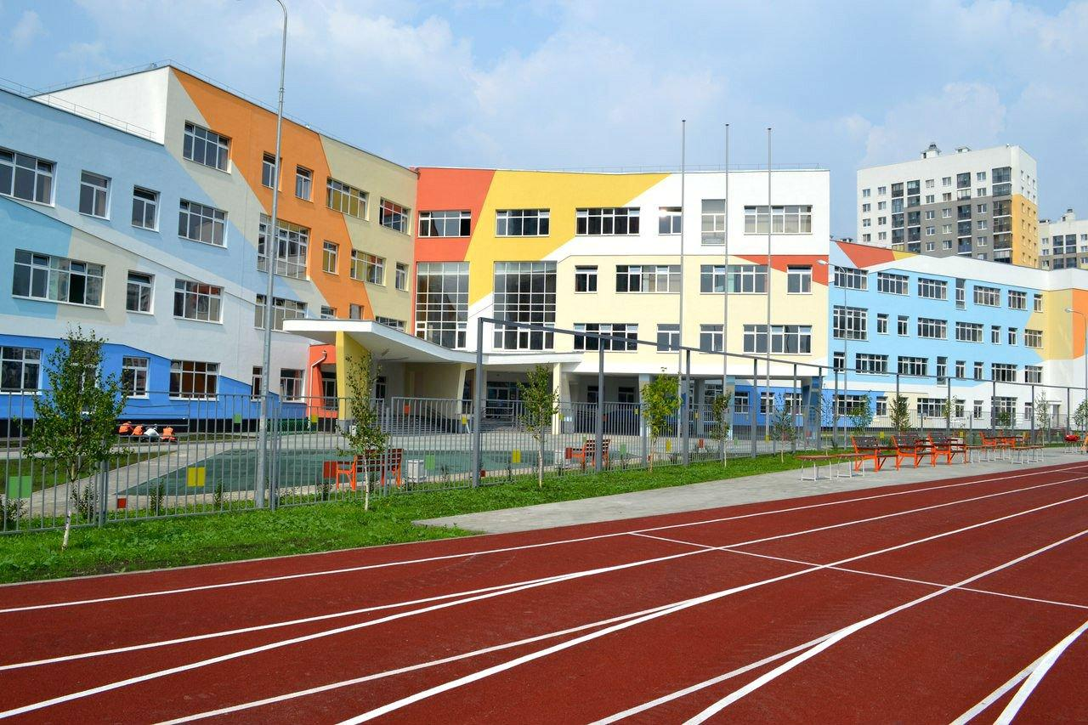
My dream school

Slide 2
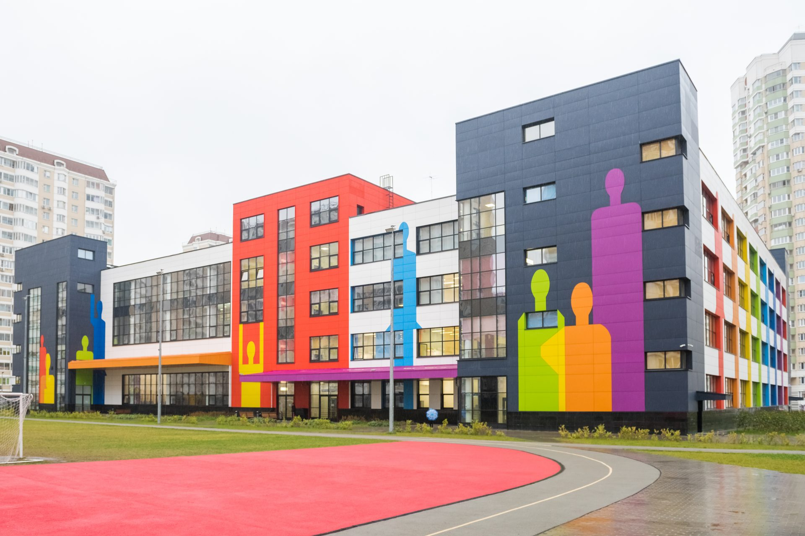
my school dreams must be as big as in Moscow, but there must be as good teachers as in our Turgenevo school.

Slide 3
Comparison of Moscow school and Turgenev school
Turgenevo
Moscow

Slide 4
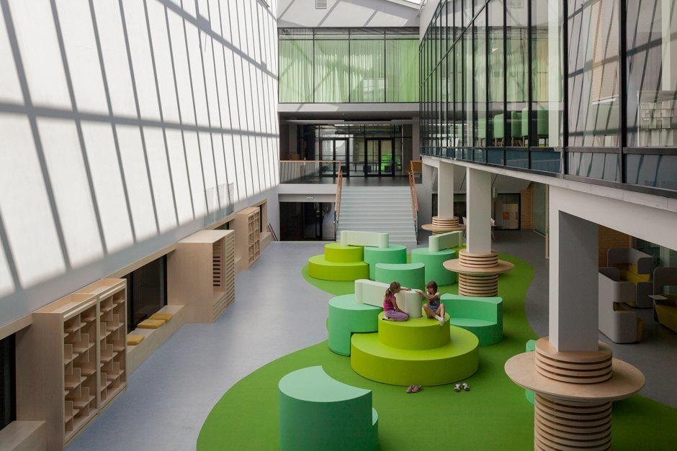
My dream school looks like this:

Slide 5
It should be like this:
My dream school is big, beautiful and bright. Homework just doesn't exist. Each student has his own computer, which he can use for educational purposes
There is a Relaxing area around the building. Beautiful benches, lawn, flower beds, where you can relax during the changes

Slide 6
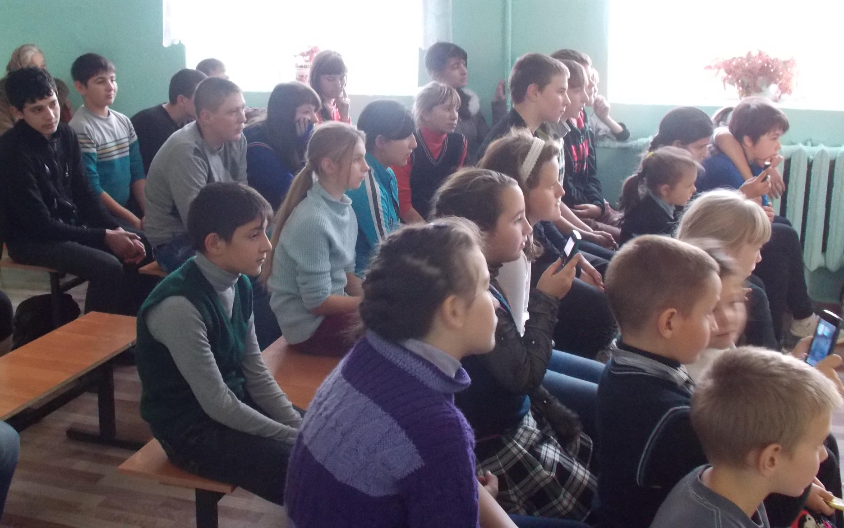
I like my school because it's small and it's always fun

Slide 7
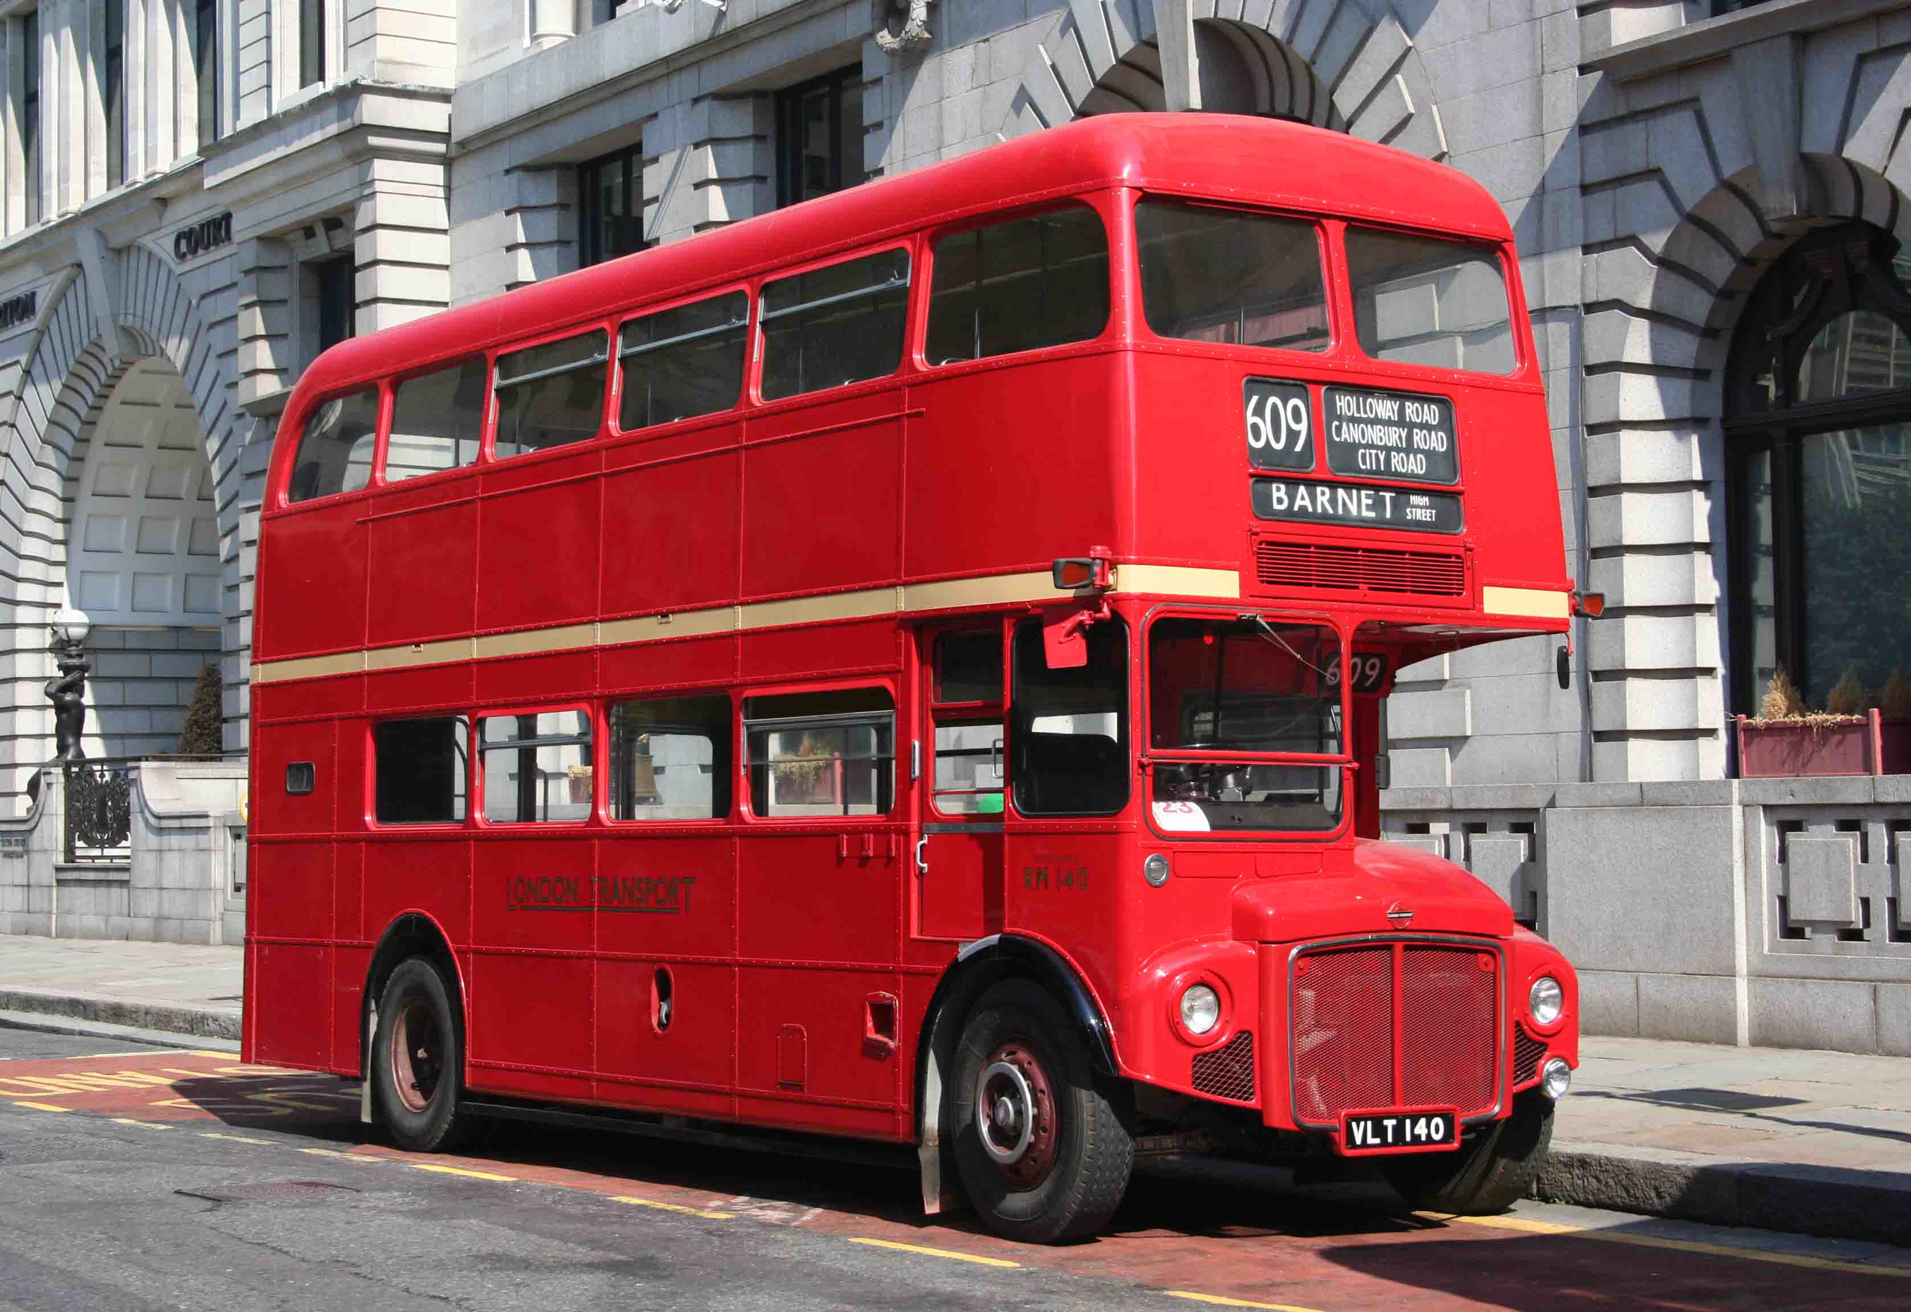
We always go somewhere

Slide 8
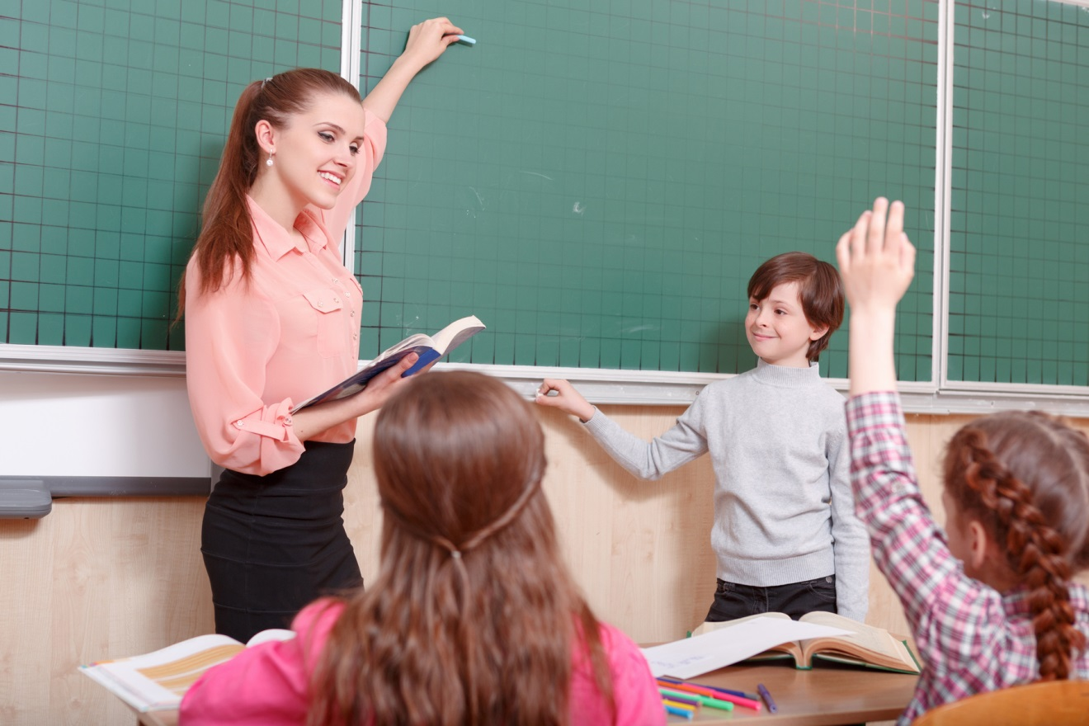
I like our school teachers they are kind and always give the right advice!

Slide 9
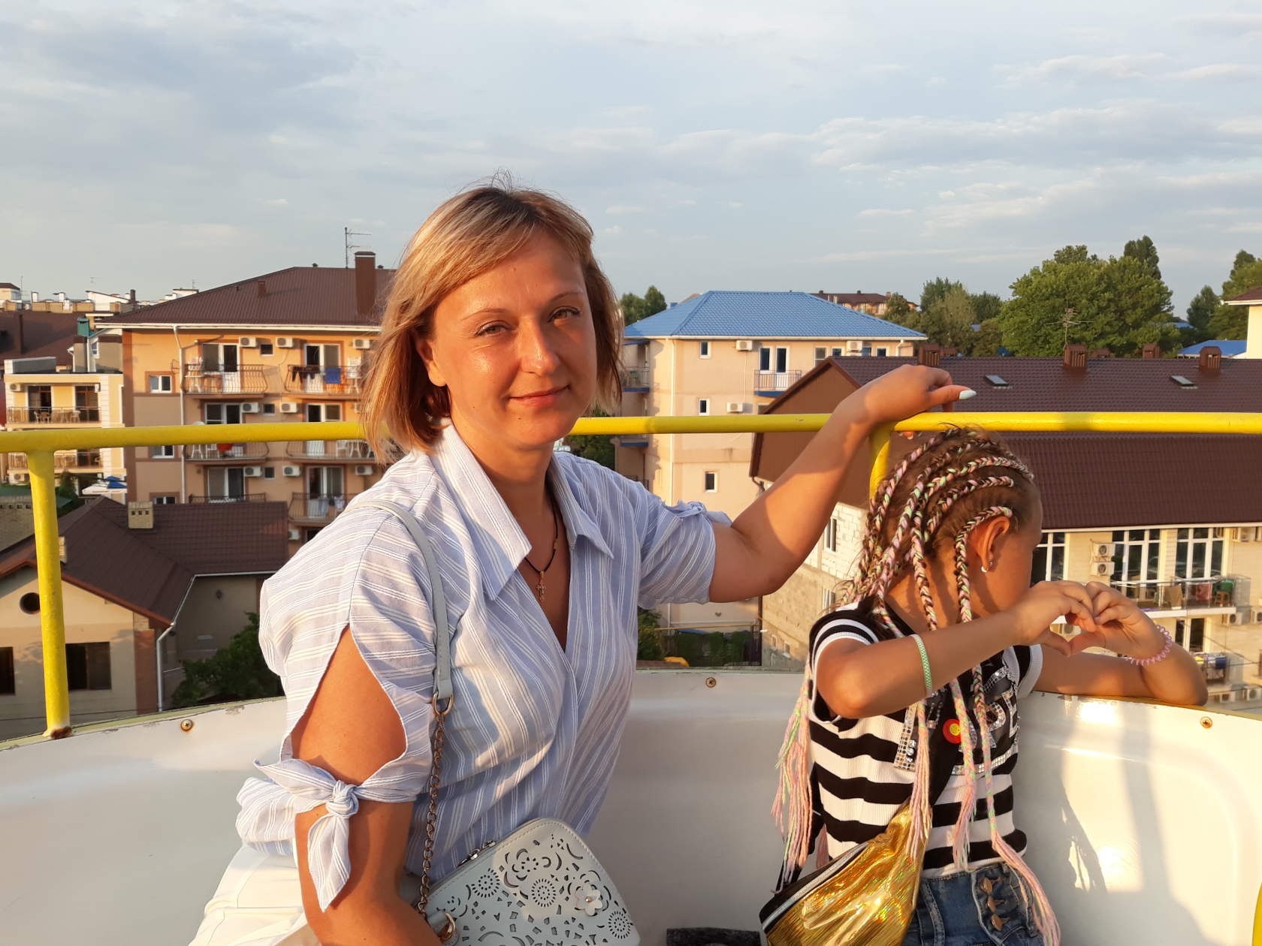
Olga Alexandrovna
Very good teacher of the English language, always help if something does not work, sometimes can be angry. We love you very much!

Slide 10
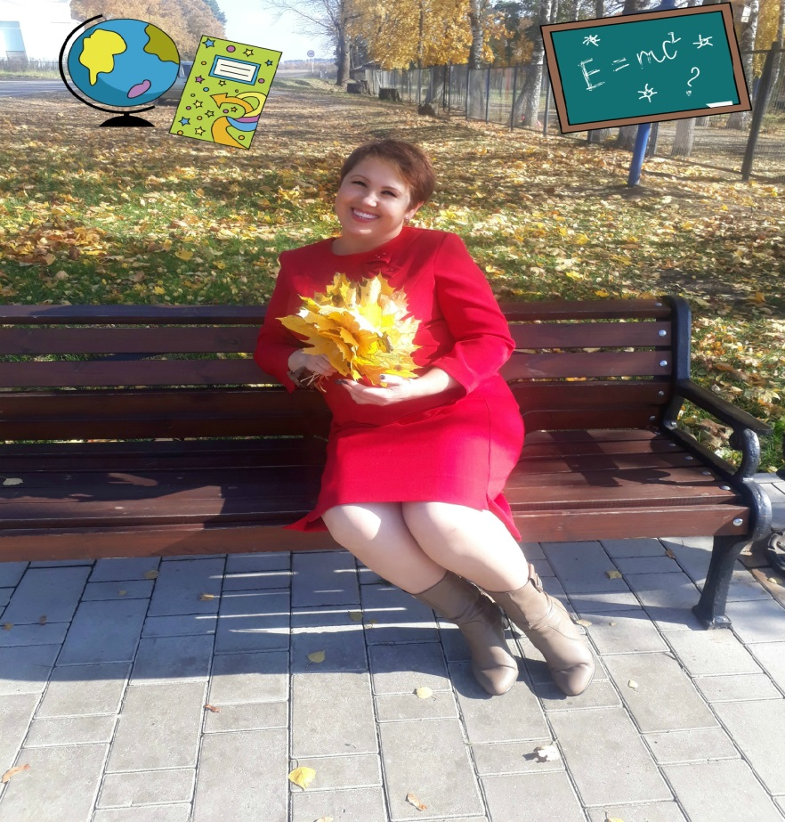
Victoria Bronislavovna
Victoria Bronislavovna teaches us Russian and literature. She helps us to learn something interesting and new. We love her very much!

Slide 11
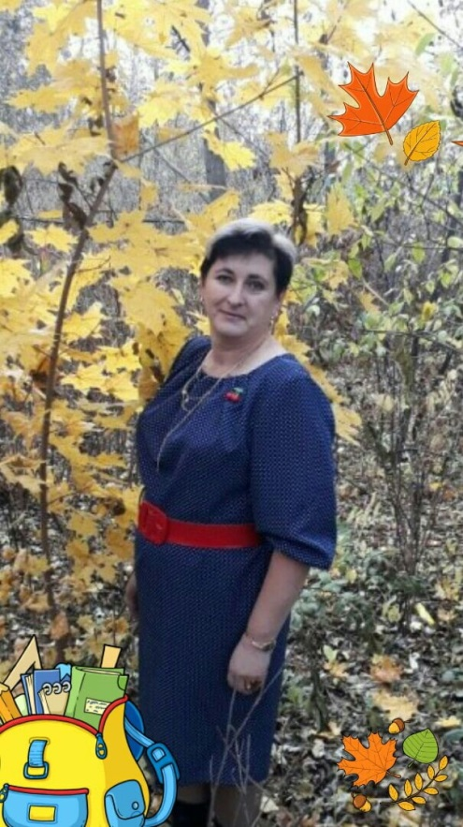
Elena Alekseevna
Elena Alekseevna, the teacher of algebra and geometry, is very fun, her lessons are interesting, sometimes we can smile. We love you very much!

