Slide 1
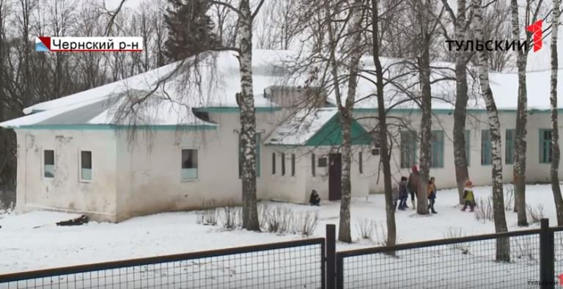
my project for the English language

Slide 2
My school : St. Petersburg
My school
St. Petersburg
our school is small and few students study here
0:
in our school lessons last 40 minutes, maximum number of lessons in day is 7
1:
this school is big and there are many students
1
in St. Petersburg school 50 minutes lessons, in day can be 8
0

Slide 3
St. Petersburg school
this is what St. Petersburg school looks like

Slide 4
My school
this is what our school looks like

Slide 5
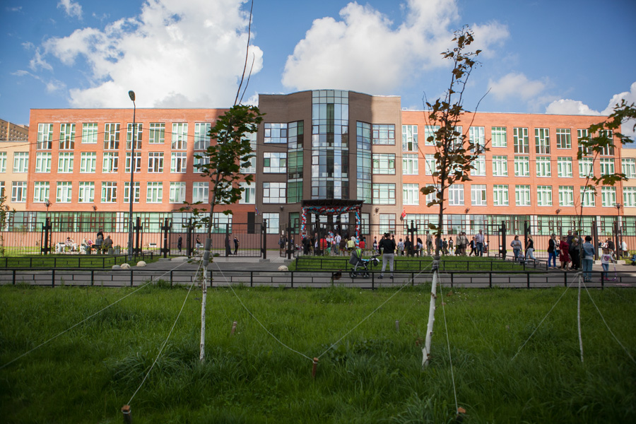
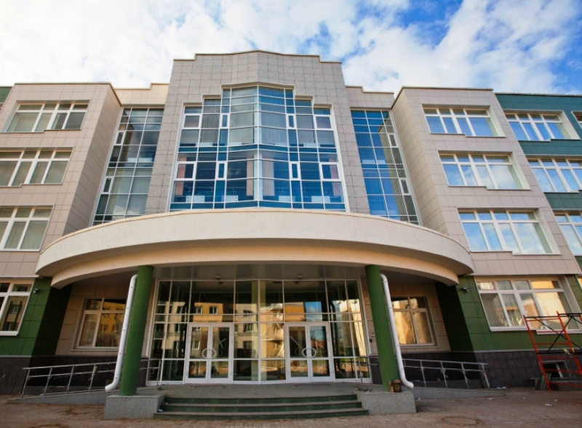
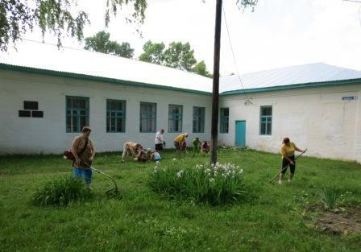
this is what our school looks like

Slide 6
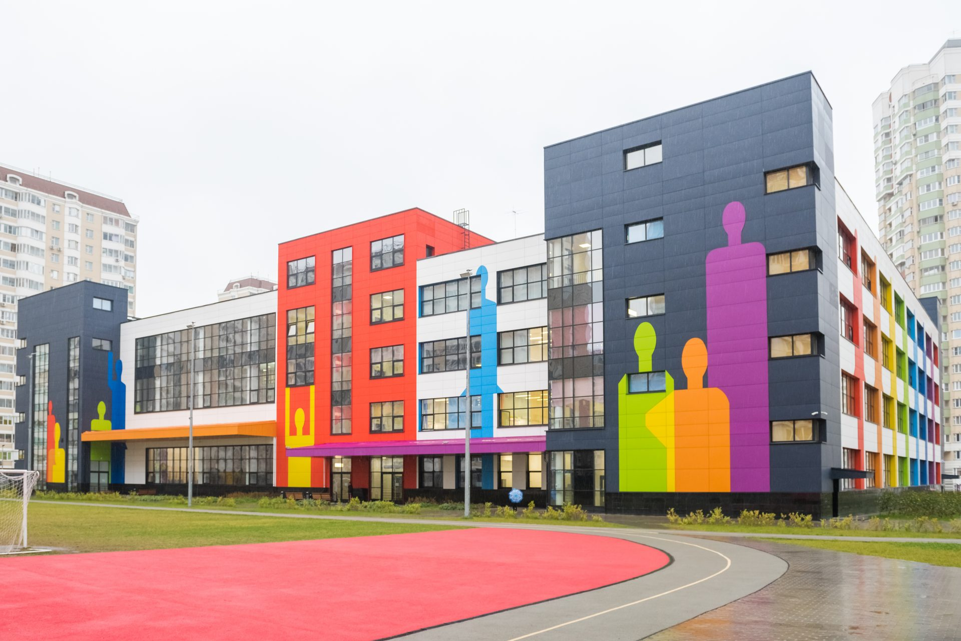
I'd like our school to look like this

Slide 7
here we can see that our school is different from the one that I want

Slide 8
well, let's sum up the battle of schools Turgenev school: St. Petersburg school
1:
2

Slide 9
the winner is the St. Petersburg school

